Slide 1

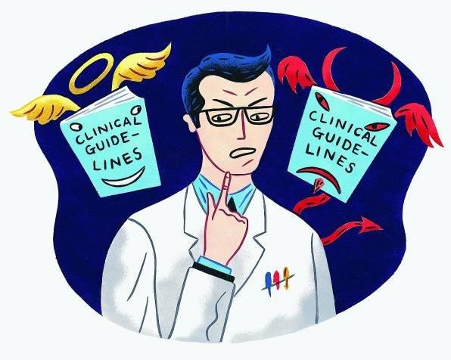
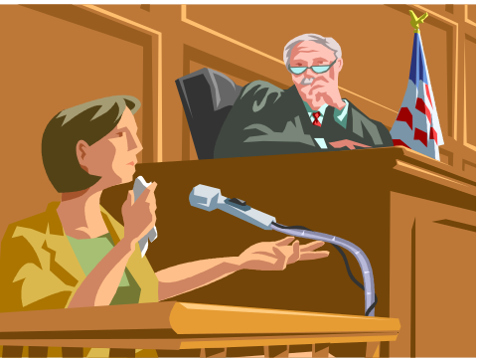
Legal and Ethical impactions of Sham Peer Review
Jonathan Davies, LLM, FACLM, FRSM
davies@med-law.co.il

Slide 2
Sham Peer Review – Ethical and Legal implications
Peer review in Medicine and Science act as fuel to improve patient safety.
On the other hand Sham peer Review has the opposite effect and its consequences are endanger patient safety by cover up of wrong and dangerous behavior that derive from mistakes
Sham Peer review is like a cancer cells within the system that attacks not only the physician involved but also patient safety, in the sense that patients become the main victim in the arena, but also the public looses an excellent and conscious professional.
SPR has legal, Ethical and economic implications that can effect patient safety.
You are about to hear today 4 presentations that will show how Sham Peer review became a silent Epidemic in workplace at large and has fatel consequences on patient safty in medical institutions.
I would like to dedicate this session to Dr. Eli Milgalter. you will hear his story . And to thank his widow Aviva that is with us. She continues to fight for patient safety publicly and legaly.

Slide 3
SPR in Israeli HS appears in different manners
First, as a tool to diminish expert opinion credibility in order to influence the court in Medical malpractice cases or in other issues.
Second, as a tool to eliminate experts from testifying against the interests of medical professional bodies.
Third, as a tool to eliminate professionals who are whistleblowers, competitors or become a threat to the medical institution by protecting patient safety and revealing cover-up of Medical Malpractice.
The SPR against professionals are done in very shrewd and sophisticated tactics under different clauses of Immunity, that puts the physician on the defense and intended to prove that his conduct is against the interest of the institution.
The first two cases are considered as soft SPR as they can cause economical damage while their physical and emotional implications are minimal.
The third example can amount to hard core SPR when it has emotional and physical implication and could effect patient safety.

Slide 4
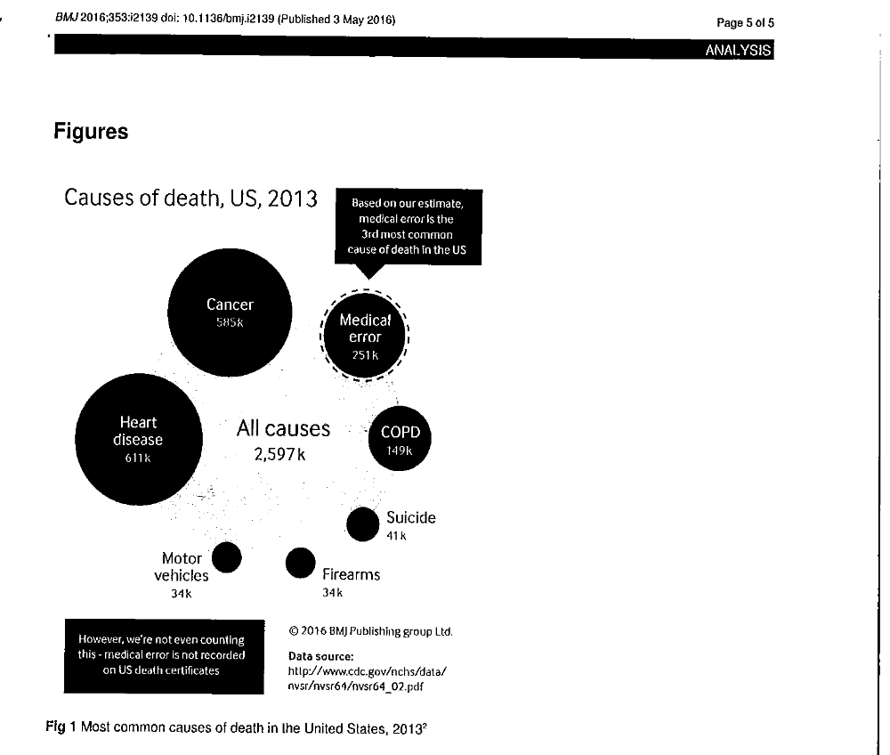
251K died in the USA in 2013 due to medical error

Slide 5
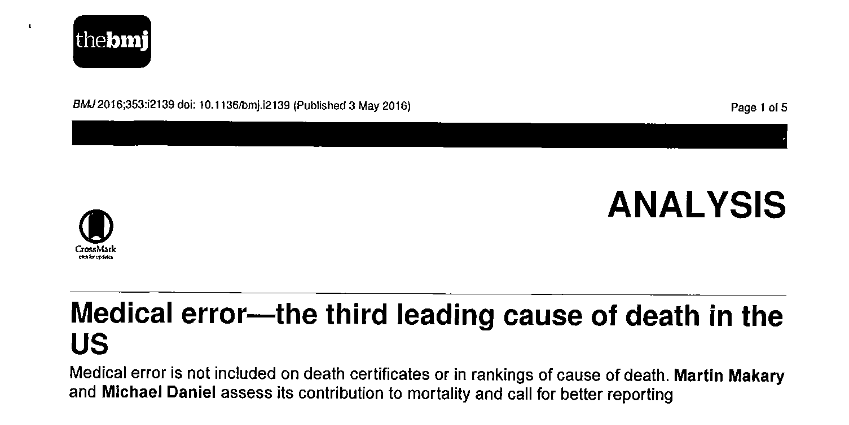
Is there causation between the following heading and sham Peer Review?

Slide 6
Ethical and economic implications
SPR raises legal issues in different areas of the law, namely contract law, employment relations between physician and the medical institution involved Labor Court has the sole jurisdiction
It can also raise questions of defamation and cause of action for personal injury in particular cases where the physician was emotionaly harmed
These claims are filed to civil courts Tort cases
In cases where patient safety is involved ethical questions of the scope of Immunity given to the medical institution is used as a tool to cover wrongful conduct complaints for disciplinary hearings and unethical conduct are filed to the MoH
SPR has legal, Ethical and economic implications that can effect patient safety.
When we are dealing with patient secrecy Full immunity allows SPR to take place and avoids whistle blowers from testifying.

Slide 7
Physical and emotional implications
All victims of sham peer review suffer mental stress.
Some suffer anxiety and depression.
Some suffer depression so severe that suicide is the outcome.
Some suffer the equivalent of post-traumatic stress disorder.
Physical illness following sham peer review is common
In some cases there is a detrition of existing illnesses.
Proving the causal link is challenging.

Slide 8
SPR in Israeli Hospitals - The Milgalter Case
Dr. Eli Milgalter was the Director of the Heart Transplant Unit at Hadassah Medical Center in Jerusalem, and was appointed as the Director of the Pediatric Cardiothoracic Surgery Unit. The unit was a candidate for the Nobel Prize due to its contribution to the special relationship with the Peres Center that referred Palestinian patients to Hadassah.
Dr. Milgalter was also a senior lecturer at the Hebrew University.
Dr. Milgalter was an exceptional surgeon in his abilities and he was highly thought of by peers and patients alike. He specialized in both pediatric and adult surgery.
Dr Milgalter worked for 37 years in Hadassah and died in 2015 from stress that led to a heart attack. In the last 7 years of his life he underwent a brutal Sham Peer Review conducted by the head of the Cardiothoracic Surgery Department, who recurrently risked patient safety in order to destroy Dr. Milgalter’s career.
Dr. Milgalter was a whistleblower who warned in real-time against faults in the hospital.
Recently my office has filed a wrongful death lawsuit against Hadassah hospital claiming that his sudden death was caused by sham peer review and tortious behavior.
Notes:
Changed the order of the bullets, reworded bullet # 4 above to be clearer and focused on SPR, , changed name of department/unit to “cardiothoracic surgery dept.”, deleted the part the end that said he died from a stroke

Slide 9
IGNORING warnings of misconduct endangering patient safety
In July 2009, with the increase of the cases where harm was caused to patients, Dr Milgalter, driven by his conscious and moral obligation, sent a warning letter to Hadassah’s management, titled "Improper management could kill patients!" “ where he lists the factual events since the appointment of the new head of the department:
Dr. Milgalter warned in his letter of the risks to patient safety in the department.
The hospital’s CEO ignored the content of the letter and instructed all other recipients of the letter to ignore his warnings as well.
Following his warnings about the department management in a manner that endangers patients, Dr Milgalter received a formal complaint that his behavior was unethical and he was summoned to a disciplinary hearing in an improper procedure.
As a sanction the extension of Dr. Milgalter’s appointment as the director of the unit was upheld until the results of the disciplinary hearing.

Slide 10
The Milgalter case - time line of SPR
  2008-2011 Dr Milgalter a cardiac surgeon warns Hadassah Management about various practice endangering patients’ lives from unwarranted risks.
  Hadassah ignores Dr Milgalter warnings and soon after two children die and severely damaged due to medical malpractice & criminal conduct.
  Instead of preventing patients hazards, Hadassah initiated sham peer review proceedings to destroy Dr. Migrater's career.
  Dr Milgalter suffers emotional stress due to SPR that detreats his diabetes effects his eyesight and he is prohibited to operate.
  Dr Milgalter continues to suffer from SPR. He demands to testify to the MoH about his warnings that could avoid the death and unnecessary injury but is ignored. The department is moved to another building but he doesn't receive a room. His academic and professional titles is taken.
  Dr. Milgalter dies of sudden cardiac arrest.
  Aviva Milgalter, widow of Dr. Eli Milgalter starts a public campaign for patient safety and protecting Whistleblowers in medical institutions.
  Our office files a wrongful death lawsuit against Hadassah hospital and Oz Shapira on behalf of Aviva Milgalter, widow of Dr. Eli Milgalter.

Slide 11
Tactics of Sham Peer review against Dr. Milgalter
Since the appointment of a new director of the Cardiothoracic Surgery Department, Dr Milgalter’s authority and reputation were abused , and he was exposed to a series of harmful actions and procedures that amounted to a tortious sham peer review as follows:
  Changing the surgery program and canceling the regular surgery days of certain physicians in the department, in order to enlarge the director’s private patient list.
  Decreasing the number of Dr. Milgalter’s patients on the weekly surgery schedule.
  Taking away Dr. Milgalter’s permanent professional staff in pediatric cardiac surgery.
  Removing Dr. Milgalter from the teaching staff at the School of Medicine with the allegation that his teaching quality was unsuitable despite the fact that Dr. Milgalter was considered to be an excellent lecturer at the School of Medicine.
  Adopting arbitrary sanctions against Dr. Milgalter, including forbidding him from conducting surgery for lengthy periods, forbidding his entry into the catheterization unit.
  Removing Dr. Milgalter from the consultation program for internal medicine departments, and preventing referrals of medical tourism to him.
Notes:
Changed department name to “cardiothoracic”, re worded some of the bullets to correct grammar/make them clearer (i.e. changed “splitting“ to “removing”)

Slide 12
Tactics of Sham Peer review against Dr. Milgalter
Since the appointment of a new director of the Chest Heart Surgery Department ,Dr Milgalter’s authority and reputation were abused , and he exposed to a series of harmful actions and procedures that amounted to a tortious sham peer review as follows:
  Changing the surgery program and canceling the surgery days of certain physicians in the department, in order to enlarge the director’s private patient list.
  Decreasing Dr. Milgalter patient list in the surgery program plan.
  Splitting Dr. Milgalter from permanent professional staff in pediatric cardiac surgery.
  Removing Dr. Milgalter from the teaching staff at the School of Medicine with the allegation that his teaching quality was unsuitable despite the fact that Dr. Milgalter was considered to be an excellent lecturer at the School of Medicine .
  Adopting arbitrary sanctions against Dr. Milgalter, including forbidding him from surgery for lengthy periods, forbidding his entry into the catheterization clinic.
  splitting him from the consultation program for internal medicine departments, and preventing him from referrals of medical tourism.

Slide 13
Endangering Patient safety
Out of all the episodes of which Dr Milgalter had warned of in the detailed letters to the hospital management, two events where fatal. the R.H. episode and the A.T. episode. An investigation committee was established at the Ministry of Health followed by a police investigation with a suspicion of criminality.
The R.H. Episode
At the direct order of the Director, the staff was instructed not to call Dr Milgalter who was on night duty despite the fact that he was present at the hospital. Post factum it became clear that this instruction was fatal as a child wasn’t treated and died from a cardiac complication.
Had he been called immediately on her admission to the emergency room, he would have diagnosed her coronary condition, applied timely emergency medical aid, and the infant would have survived.
The A.T. episode,
Dr Milgalter’ s warnings about the defaults and procedures that endanger the patients under the Director’s management fell on deaf ears. Together with other senior physicians, Dr Milgalter warned of the fact that operating room no. 8 was unsuitable for pediatric surgery due to the infrastructure, and that pediatric surgery in this room could cause a disaster. Dr Milgalter refused to operate in this room despite the threats of the Director to adopt measures against him if he did not operate there.
On January 23, 2011 the risk that he had warned of occurred. a resuscitation device was connected erroneously to a carbon dioxide valve instead of an oxygen valve and, as a result of this, severe and irreversible brain damage was caused to the child A.T.

Slide 14
The claim of Dr Milgalter’s estate
Further to Dr. Milgalter’ s death his estate filed a claim of wrongful death as a result of the harmful conduct of the Defendants towards him,
This claim exposes a web of events stemming from negligent management that caused irreversible damage to physicians and patients in the Cardiothoracic Surgery Department at Hadassah under the direction of Defendants. The Defendant created a noxious work environment and hostile organizational culture within the confines of Hadassah Hospital, while sacrificing the health and endangering the lives of patients for the sake of empowering his professional status and concealing and whitewashing events of medical malpractice in the department about which the Deceased and the other department physicians had warned.
The harmful conduct towards Dr. Milgalter was perpetrated by the abuse of power of the Defendants and the absolute backing by the Hadassah Hospital administration.
Dr. Milgalter’s widow Aviva Milgalter , is now continuing his fight legally & publicly.
Notes:
Changed dept. name to cardiothoracic, corrected typos

Slide 15
Legal Immunity in Israel health System
One of the arguments in American literature shows an history of outrageous and unjustified immunity that allows sham peer review that began in the mid-1980s with a perception, probably false, that instances of malpractice by physicians were increasing.
In Israel legislation protects wrong behavior by giving immunity in different ways:
Hospitals conduct in internal investigating hearing are completely immured. This allows them to cover-up any malpractice that accrued within the medical institution.
Hospital disciplinary hearings are completely immured.
When Dr. Milgalter asked to complain to the Ministry of health and testify in front of disciplinary hearing committee, Hadassah authorities stopped him from doing so using different tactics.
Immunity of wrongful conduct within medical clinics is used as a tool to cover mistakes.
This full immunity allows sham peer review to take place in its different forms mentioned above.
Immunity allows to cover-up wrongful conduct that the physicians call Defensive Medicine and what I consider as a tool to escape accountability in Medical Malpractice cases.

Slide 16
The Double jeopardy syndrome of Sham Peer Review
Once SPR takes place in a severe manner its probably unrecoverable.
As Dr Poliner concludes in his review : “Despite the eventual return of all of my privileges, and after a jury unanimously found that defendants acted “maliciously without justification or privilege,” my reputation was ruined, and my practice was destroyed. The sham peer review was highly effective in eliminating me as a competitor, despite there being nothing wrong with the care I provided. It completely destroyed my referral sources. It is hard to undo a label of “dangerous doctor” once it has been indelibly stamped on the physician victim”.
In this story we see that all players lose. The physician, the hospital, the patients and public.
Sham Peer review is like a cancer cells within the system that attacks not only the physician involved but also patient safety, in the sense that patients become the main victim in the arena, but also the public looses an excellent and conscious professional.
So the question is how does the system avoids Sham Peer review within hospitals?

Slide 17
The Milgalter case raises some important questions:
After seeing who are the real victims of Sham Peer Review what should be done to avoid other cases as such?
Should law makers consider to abolish or diminish immunity in order to protect patient safety?
Why are the tactics of SPR in Medicine are so vicious and harmful?
What is it that SPR happens especially with cardiologists & surgeons?
How should society protect whistleblowers?
Who should be accountable to SPR?
Under what law should SPR be tried - Labor law or Torts?
Notes:
Corrected typos

Slide 18
Thank You for listening
Jonathan Davies, JD, LLM
www.med-law.co.il
davies@med-law.co.il

